Slide 1
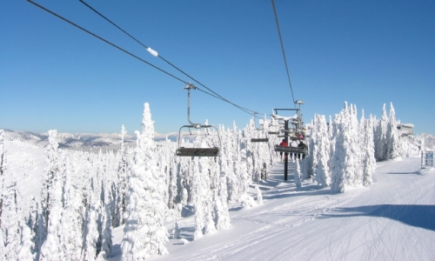
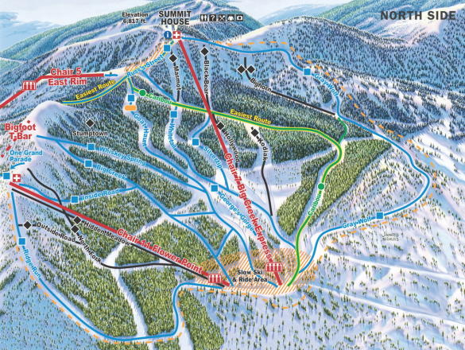
Big Mountain Ski Resort Report
https://skiwhitefish.com/

Slide 2
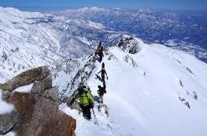
Pricing model for Big Mountain ski resort
Prince Zogli
2/12/21

Slide 3
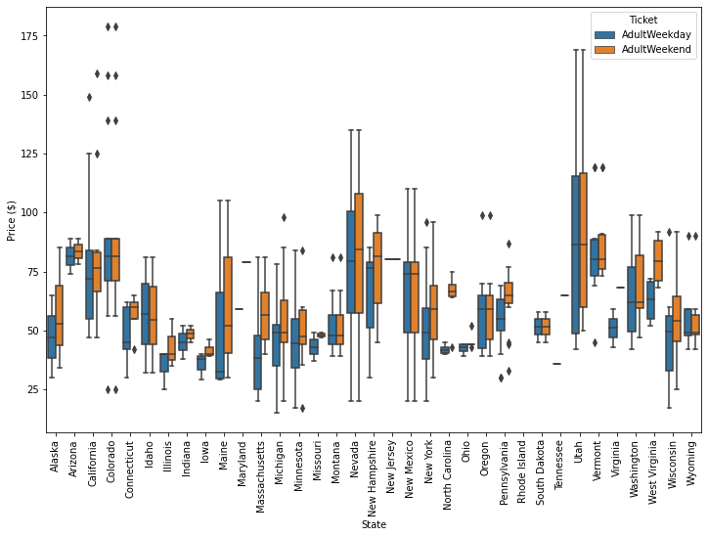
Problem identification
Ticket prices across States
Statement:
Though Big Mountain, is located in Montana which sites at #12 of states with resorts, Price of our tickets are cheaper relative to other resorts.
Overall prices at US resorts range between $25 𝑎𝑛𝑑 100.00, with Montana averaging $50.00.
Questions:
Is Big Mountain maximizing its returns, relative to its position in the market?
What facilities matter most to visitors, and which will they pay premium price to access?
Objective:
Build model to provide guidance for Big Mountain's pricing and future facility investment plans.

Slide 4
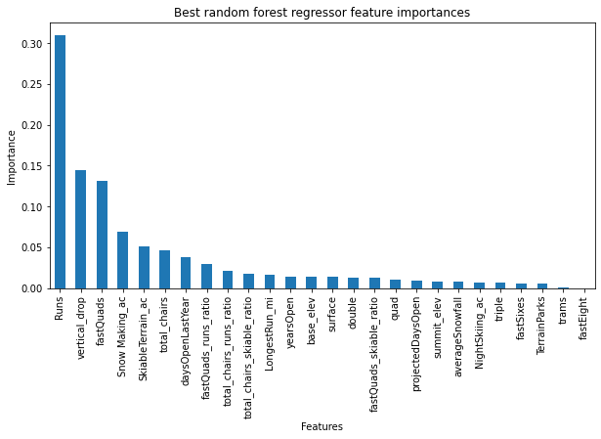
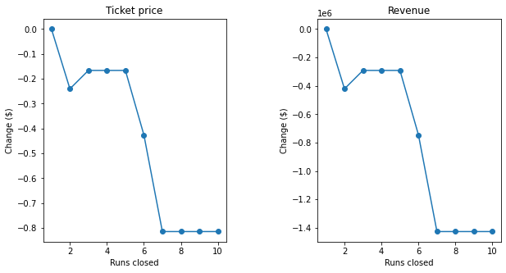
Key Findings and Recommendations
Top Facilities
The Top 6 Facilities include: Runs, Vertical Drop, FastQuads, Snow making, Skiable terrain, and total chairs
Up to 4 or 5 runs can be closed with insignificant impact on price but closing 6 runs leads to a dramatic drop in price and thus revenue
Recommendations:
Our modelled price is $93.69, relative to actual of $81.0. With a MSE of $10.17, prices can be increased by $10.00.
Increase runs and chairs by least 1, coupled with increasing the vertical drop by 150 feet and snow making by 2 acres gives the highest return at $32,375,000.00 compared to $29,231,481.00 when runs and chairs were increased by least 1, and vertical drop increased by 150 feet.

Slide 5
Modeling results and analysis

Slide 6
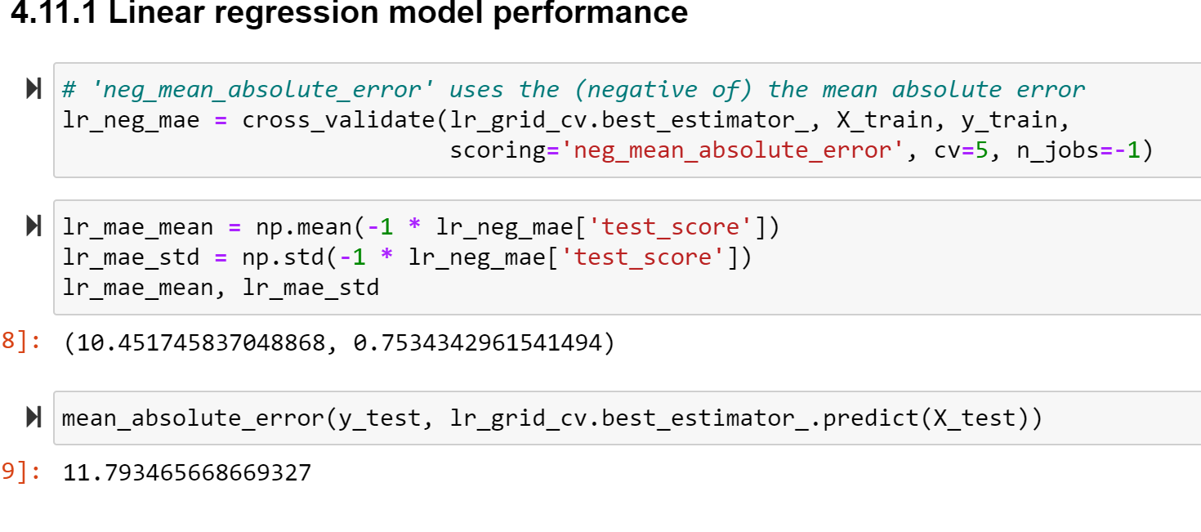
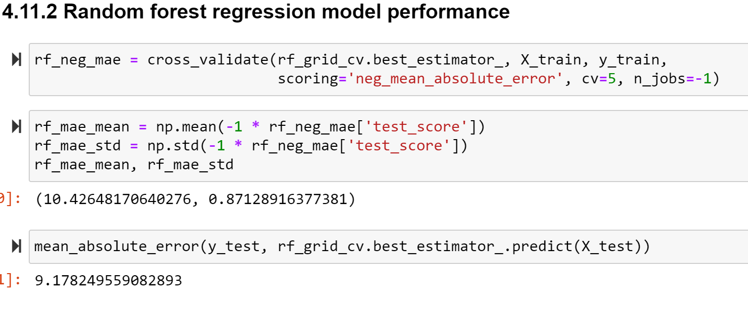
Fitting the Linear Model vs. Random Forest
The random forest model has a lower cross-validation mean absolute error of $9.17 compared with $11.8 for the Linear Model

Slide 7
Scenarios explored

Slide 8
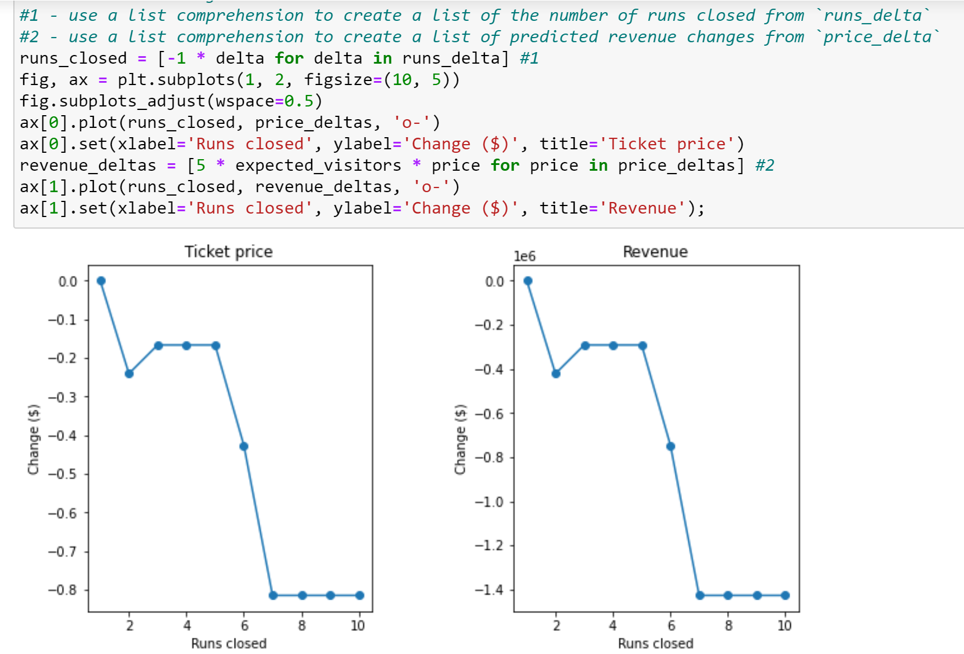
Scenario 1
Closing 2 and 3 successively reduces support for ticket price and so revenue.
If Big Mountain should close 3 runs, there is room to 4 or 5 as there's no further loss in ticket price.
However, increasing the closures down to 6 or more leads to a large drop.

Slide 9
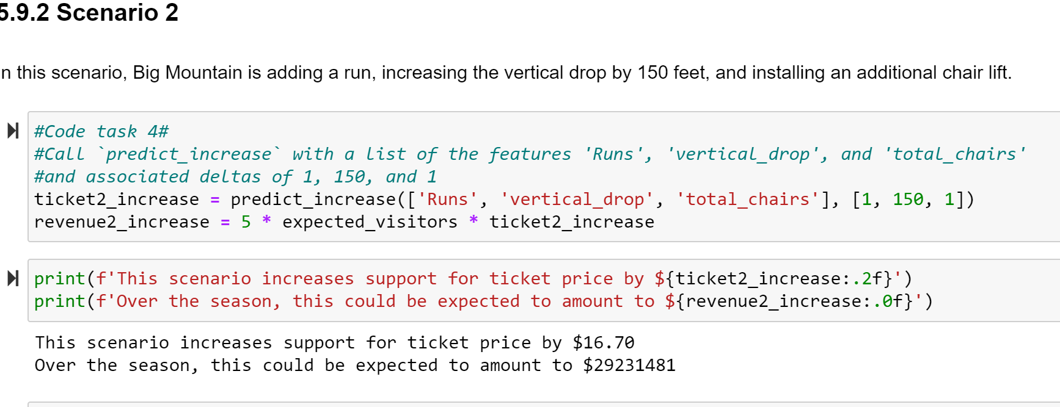
Scenario 2
This scenario increases support for ticket price by $16.70
Over the season, this could be expected to amount to $29,231,481.00 in revenue

Slide 10
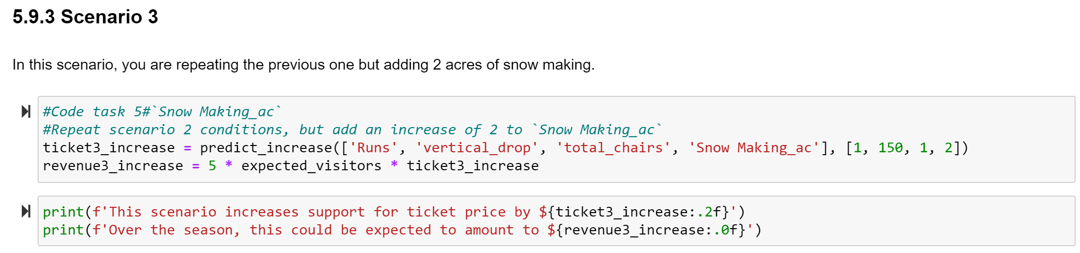
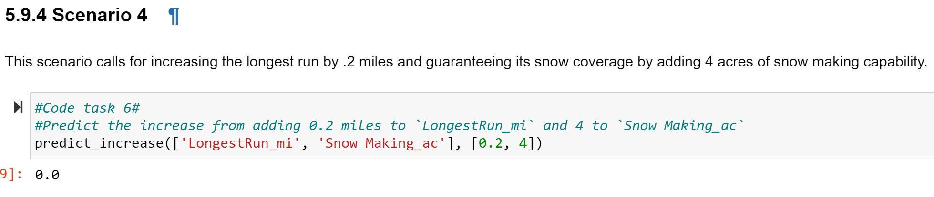
Scenario 3
This scenario increases support for ticket price by $18.50
Over the season, this could be expected to amount to $32, 375, 000 in revenue
These did not make any difference.

Slide 11
Summary and Conclusions
Random Forest model performs better than Linear model and hence adopted
Runs is the top predictor of price along with Vertical drop, chair lift, FastQuads, and Snow making.
Though Big Mountain’s actual price is $81.00 93.69 our model predicts that price can be set to $93.69.
To Justify price increase, it will be ideal to increase vertical drop by 150 feet, and add 1 run and 1 chair lift, which supports price increase by $16.70.

Slide 12
Thank you

